Slide 1
Subject matter expertise implementing, managing, and monitoring an organization’s Microsoft Azure environment..
An Azure Administrator often serves as part of a larger team dedicated to implementing your organization's cloud infrastructure.
Azure knowledge domains: administration, development, or DevOps.
Pre-Requisites : PowerShell, Azure CLI, Azure portal, and Azure Resource Manager templates
Microsoft Azure Administrator Foundation

Slide 2
Implement and manage Azure storage
Manage storage accounts
Manage data in Azure Storage
Configure Azure files and Azure blob storage
Deploy and manage Azure compute resources - VM
Configure VMs for high availability and scalability
Automate deployment and configuration of VMs
Create and configure VMs
Create and configure containers
Create and configure Web Apps
Manage Azure identities and governance – Azure AD
Manage Azure AD objects
Manage role-based access control (RBAC)
Manage subscriptions and governance
ARM Template
https://azure.microsoft.com/en-us/resources/templates/
Azure Monitoring
Monitor resources by using Azure Monitor

Slide 3
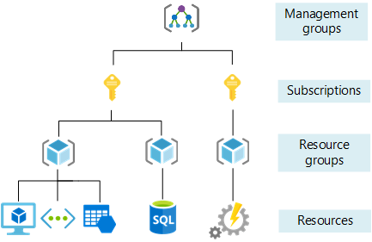
Azure Account, subscription and directory
Organize and manage multiple Azure subscriptions -Used to pay for Azure cloud services ,linked to credit card.
Azure management groups
Tenant (Azure AD tenant) -> Subscription -> Resource Group -> Resource.
A tenant is associated with a single identity (person, company, or organization) and can own one or several subscriptions
subscription is linked to a payment setup and each subscription will result in a separate bill
Every tenant is linked to a single Azure AD instance, which is shared with all tenant's subscriptions

Slide 4
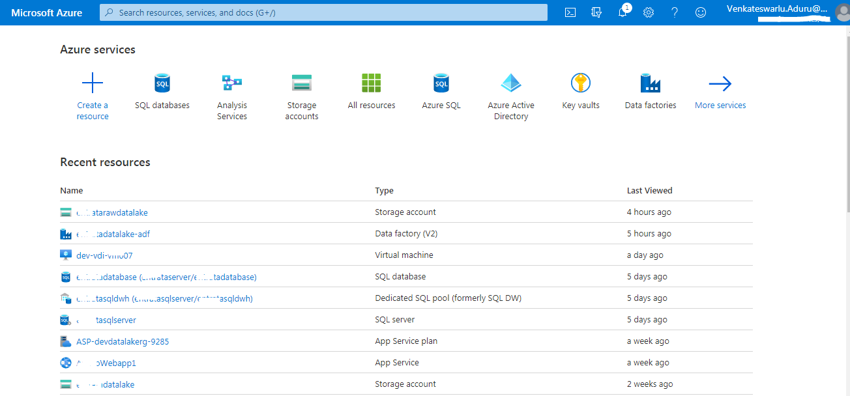
Azure Portal

Slide 5
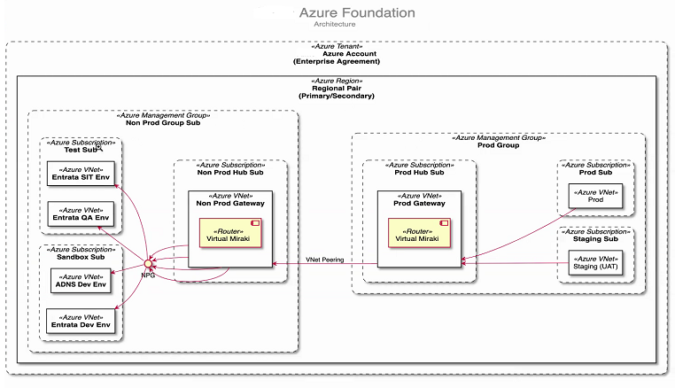
Use case
For example, MNC wants to Organize and manage multiple Azure subscriptions , Azure management groups

Slide 6
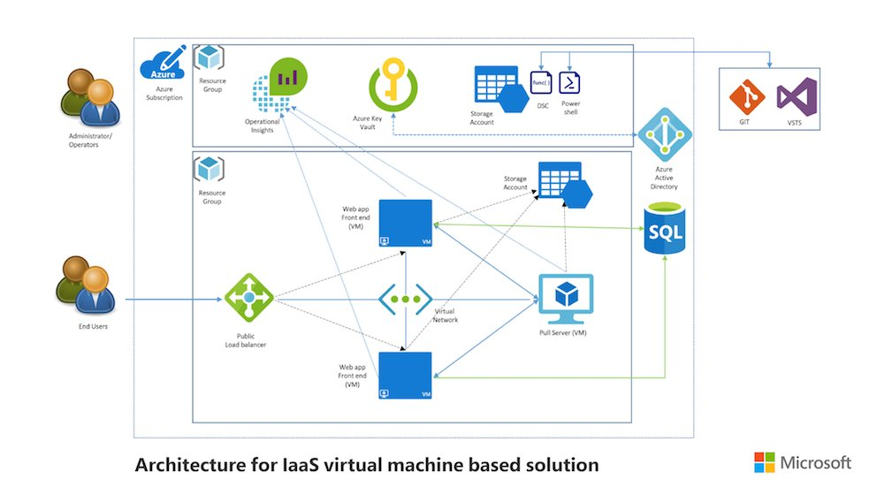
Azure Virtual Machine
Compute Units
Supported OS
VM Limitations

Slide 7
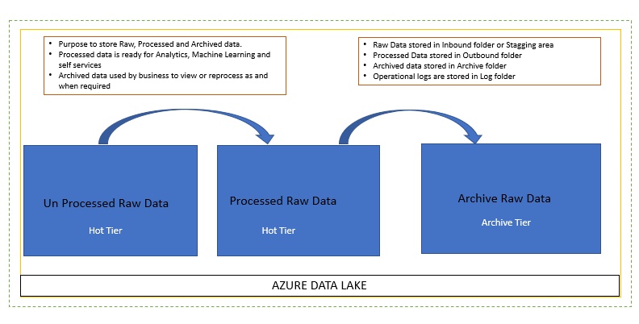
Azure Storage, type and access tier, Cost management
Type of account – GP v1 , GP v2
Relocation - LRS, GRS, RA-GRS, ZRS, GZRS
Access Tier
Hot tier
Cool tier
Archive tier
Access to the data
SAS
Storage End point : Blob storage: https://*mystorageaccount*.blob.core.windows.net
Azure Data Lake Storage Gen2: https://*mystorageaccount*.dfs.core.windows.net

Slide 8
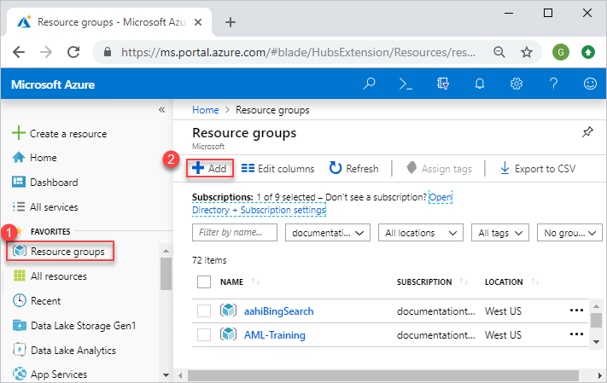
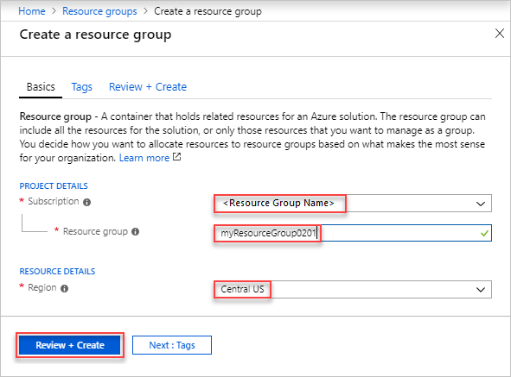
Azure Resource Group and tagging
A resource group is a container that holds related resources for an Azure solution.

Slide 9
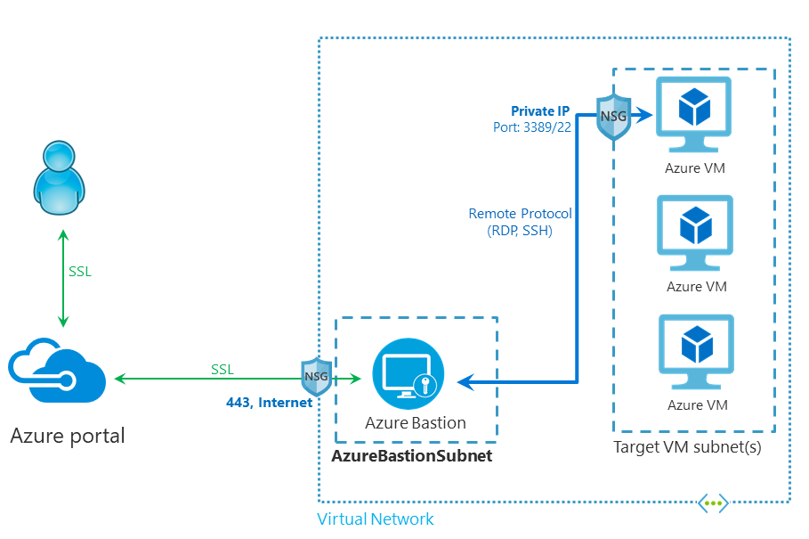
Azure Networking
Network as a service
Connect and deliver your hybrid and cloud-native applications with low-latency, Zero Trust based networking services
With more than 165,000 miles of private fiber spanning 60+ regions and 170+
Predictable performance up-to 100 GBPS through Azure ExpressRoute , Vnet
Azure Bastion
Network Fire walls
NSG (inbound and outbound)

Slide 10
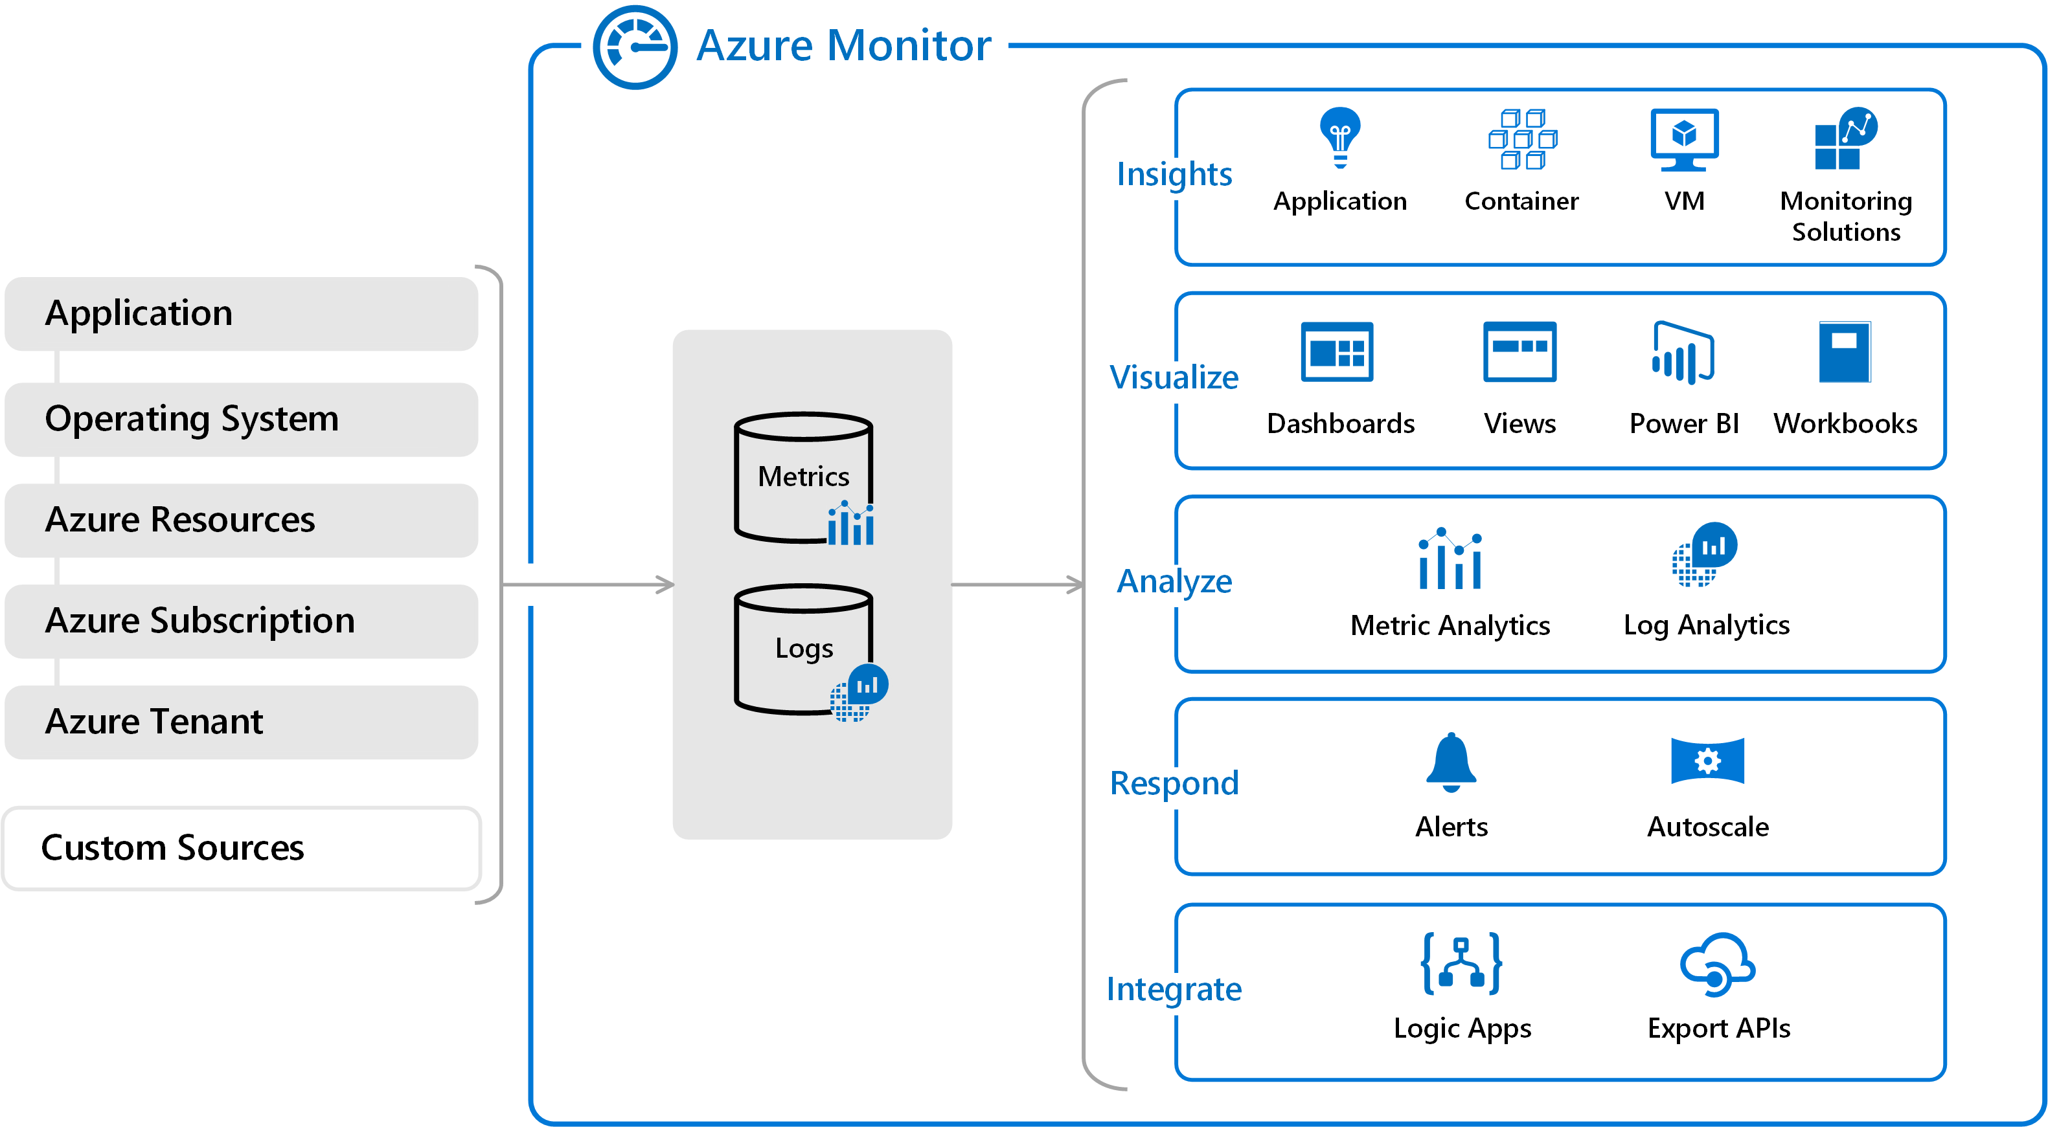
Azure Monitoring
Data stores for metrics and logs, which are the two fundamental types of data used by Azure Monitor.
Maximize the availability and performance of your applications and services.
Comprehensive solution for collecting, analyzing, and acting on telemetry from your cloud and on-premises environments.

Slide 11
Azure Data Protection and Security services
Classify your data based on sensitivity
Protect your data at all times
Storage Security
Database security
Azure Key Vault
Azure Storage Service Encryption
Azure Storage Shared Access Signatures
Azure Storage Account Keys
Azure SQL Firewall
Azure SQL Cell Level Encryption
Azure SQL Connection Encryption
Identity and access management - RBAC
Networking - NSG

Slide 12
Azure Governance and compliance
Resource access governance—the ongoing process of managing, monitoring, and auditing the use of Azure resources to meet the goals and requirements of your organization. ...
Enforce and audit your policies for any Azure service
Create compliant environments using Azure Blueprints, including resources, policies and role-access controls
Is Azure GDPR compliant?

Slide 13
Azure Fundamentals - terminology
Resource: An entity that's managed by Azure. For Ex. Azure VM, virtual networks, and storage accounts.
Subscription: A logical container for your resources, can be free trial or pay-as-you-go.
Azure account: The email address that you provide when you create an Azure subscription is the Azure account for the subscription.
Resource groups: Logical containers that you use to group related resources in a subscription.
Management groups: Logical containers that you use for one or more subscriptions.
Region: A set of Azure datacenters that are deployed inside a latency-defined perimeter.
Azure Active Directory (Azure AD) is Microsoft’s cloud-based identity and access management service, which helps your employees sign in and access resources , single sign-on (SSO) , MFA

Slide 14
Azure fundamentals - subscription purposes , administrative roles
A legal agreement
A payment agreement
A boundary of scale
An administrative boundary
Who is responsible for paying for the subscription?
Azure administrative roles
Classic subscription administrator roles - Account Administrator / Service Administrator, Owner
Azure role-based access control (RBAC) roles
Azure Active Directory (Azure AD) administrator roles

